Slide 1



Bank Account Management
KRISHNA PRASAD BANK

Slide 2
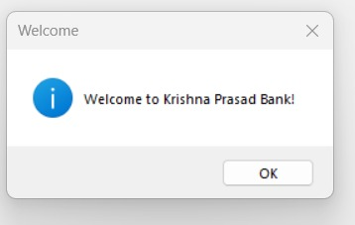
Welcome Message
Please Click on ok

Slide 3
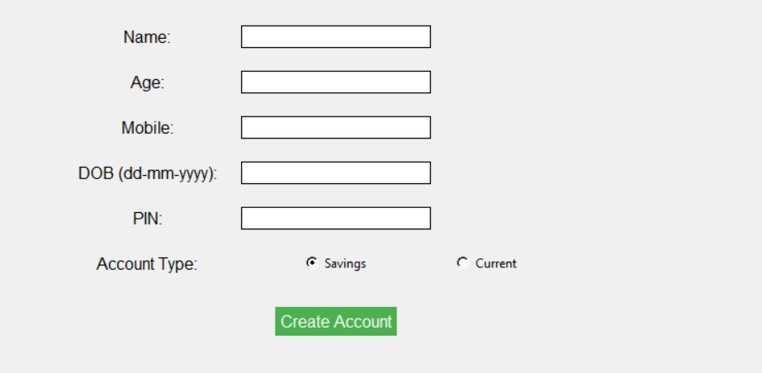
Home Page
Please fill the Form.
After filling the form Click create account button

Slide 4
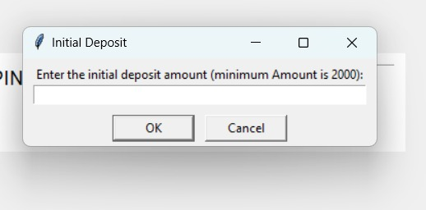
Deposit Ammout
Enter The Initial Deposit Amount Based on Account Type.

Slide 5
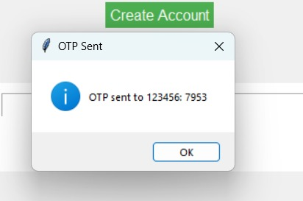
OTP Generator
After Deposit the Amount OTP will be Generated.

Slide 6
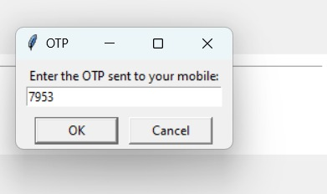
Enter OTP
Enter the correct OTP it has been sent the mobile number

Slide 7
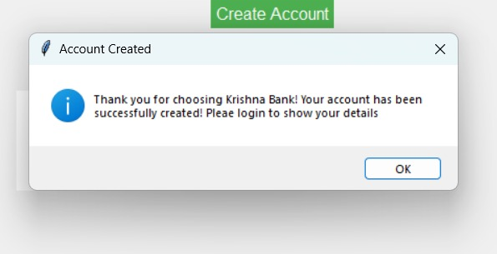
Message
After completing all the things it showing thank you for choosing krishna bank

Slide 8
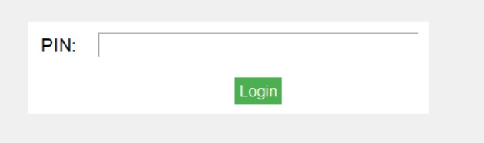
Login
If you want to deposit amount or withdrawn amount or show history. Please click login it based on PIN. Enter the correct PIN it will login.

Slide 9
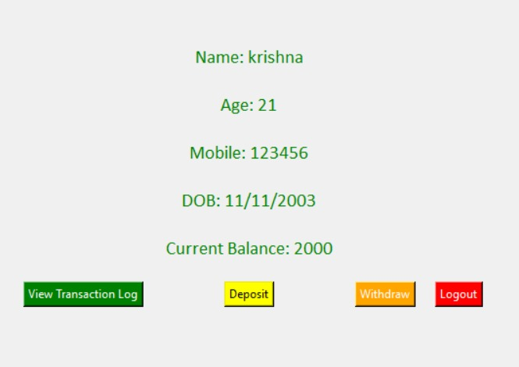
Details
Show the details of the customer

